Slide 1
NTE 1010
Introduction to Finance for Engineers
Spring 2020
week
13
International Financial System

Slide 2
NTE 1010 – Introduction to Finance for Engineers
International Financial System
Balance of Payments
A bookkeeping system for recording all receipts and payments (private sector and government)
that have a direct bearing on the movement of funds betweena nation and foreign countries.
The current account shows international transactions that involve
currently produced goods and services.
The difference between merchandise exports and imports, the net receipts from trade,
is called the trade balance.
Additional items included in the current account are
the net receipts (cash flows received from abroad minus cash flows sent abroad)
from three categories:
investment income
service transactions
unilateral transfers (gifts, pensions, and foreign aid)
Another important item in the balance of payments is the capital account, the net receipts from capital transactions (e.g., purchases of stocks and bonds, bank loans, etc.).
The sum of the current account and the capital account equals
the official reserve transactions balance (net change in government international reserves).
When economists refer to a surplus or deficit in the balance of payments,
they actually mean a surplus or deficit in the offical reserve transactions balance.

Slide 3
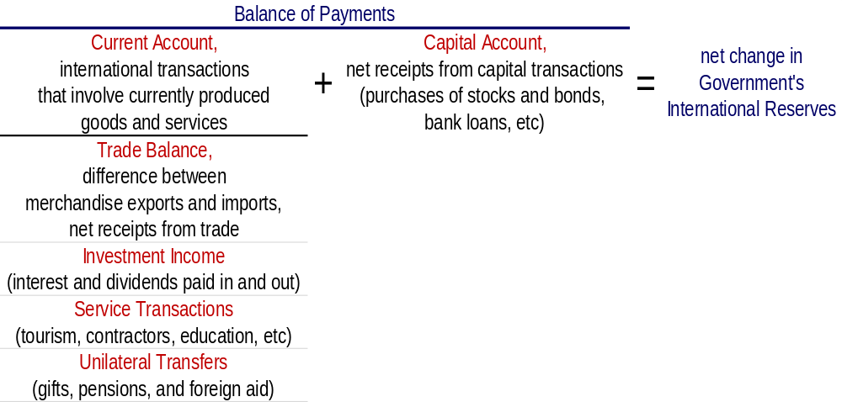
NTE 1010 – Introduction to Finance for Engineers
International Financial System
Balance of Payments
Because the balance of payments must balance, the official transactions balance, which equals the current account plus the capital account, tells us the net amount of international reserves that must move between governments (as represented by their central banks) to finance international transactions.

Slide 4
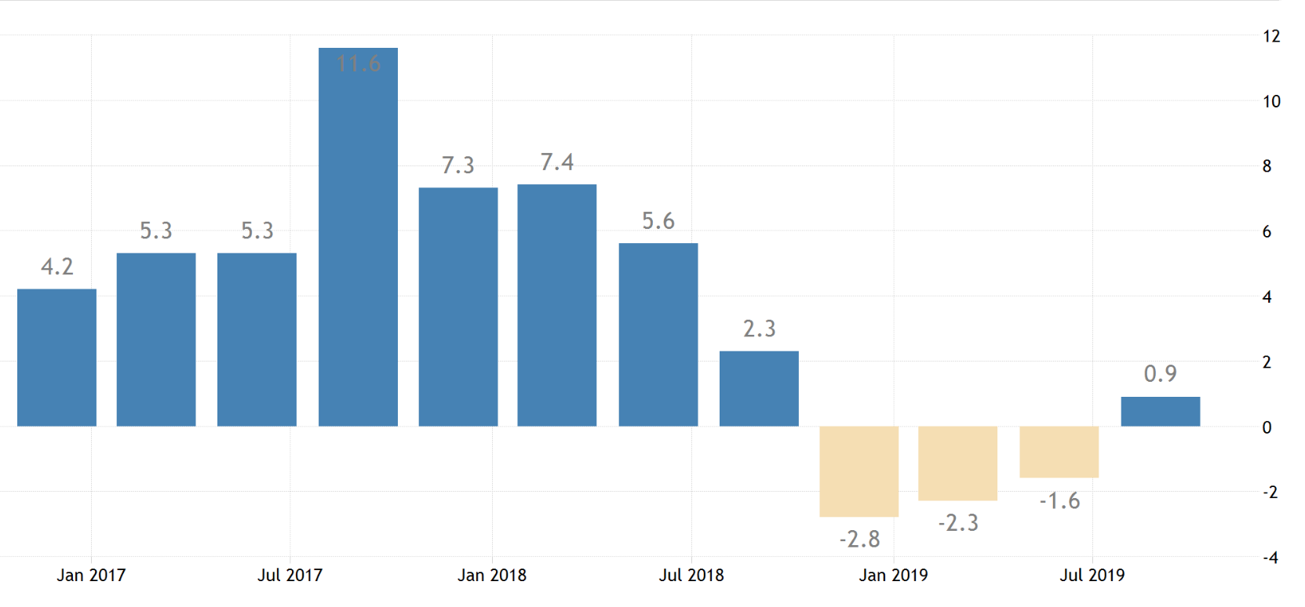
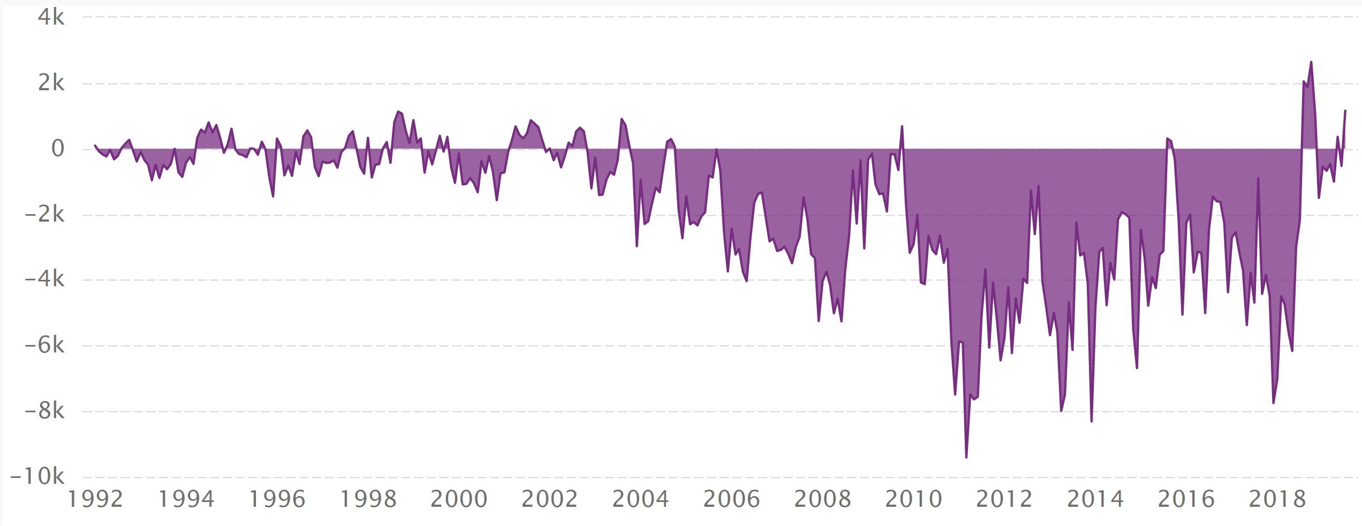
NTE 1010 – Introduction to Finance for Engineers
International Financial System
Current Account Balance of Turkey
Qly GDP Growth Rate
Monthly Current Account Balance (billion USD)

Slide 5
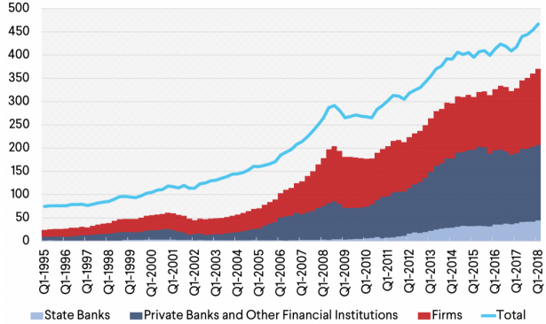
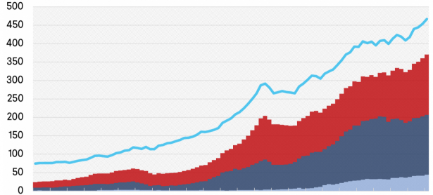
NTE 1010 – Intro to Finance for Engr
International Financial System
A New Economic Model after 2003 in Turkey:
Growth funded by borrowing
Gnl Govt excl St Banks
F
Monthly Current Account Balance (billion USD)

Slide 6
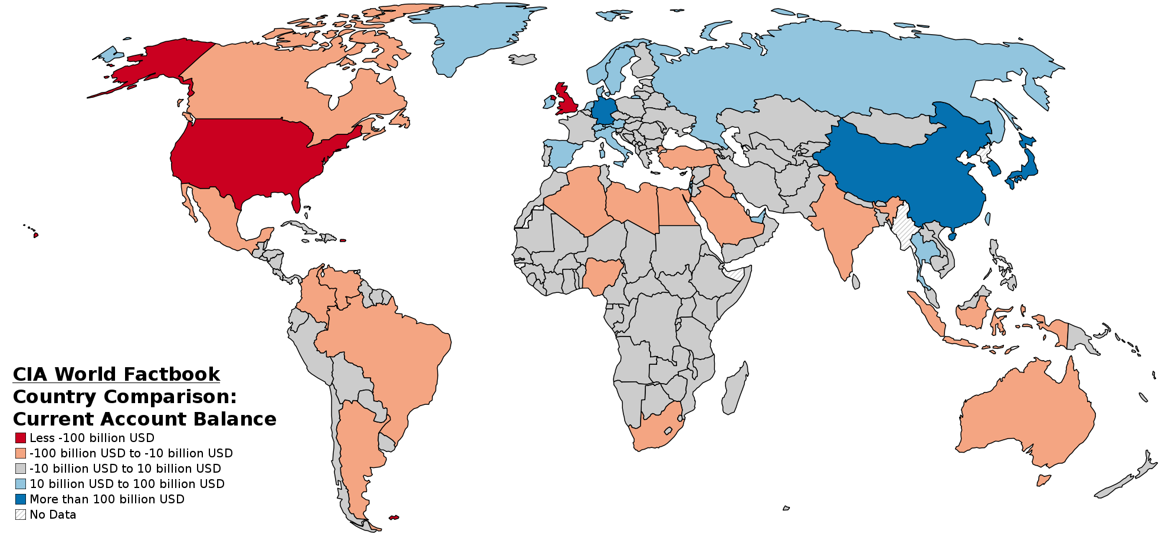
NTE 1010 – Introduction to Finance for Engineers
International Financial System
Current Account Balance in the World

Slide 7
NTE 1010 – Introduction to Finance for Engineers
International Financial System
Exchange Rate Regimes
Classified into two basic types; «Fixed» and «Floating»,
and a third one which is more or less in between, namely, «Managed Float».
In a fixed exchange rate regime,
the value of a currency is pegged relative to
the value of another currency (called the anchor currency)
so that the exchange rate is fixed in terms of the anchor currency.
In a floating exchange rate regime,
the value of a currency is allowed to fluctuate against all other currencies.
When countries intervene in foreign exchange markets
in an attempt to influence their exchange rates
by buying and selling foreign assets,
the regime is referred to as a managed float regime (or a dirty float).

Slide 8
NTE 1010 – Introduction to Finance for Engineers
International Financial System
Past Exchange Rate Regimes
Before World War I,
the world economy operated under the gold standard,
a fixed exchange rate regime
in which the currency of most countries was convertible directly into gold at fixed rates,
so exchange rates between currencies were also fixed.
After World War II,
a fixed exchange rate system known as the Bretton Woods system was set up.
(Bretton Woods is a town in the US.)
As the US emerged from WWII as the world’s largest economic power, with over half of the world’s manufacturing capacity and the greater part of the world’s gold, the Bretton Woods system of fixed exchange rates was based on the convertibility of US dollars into gold at 35$ per ounce.
Gold as well as US dollars were to kept by other countries as international reserves
with US guaranteeing to provide an ounce of gold for 35$ on demand.
As a result, US $ became the reserve currency of the world.
The Bretton Woods system was abondoned in 1971
with US declaring that it will no longer provide gold in return for US $ anymore.
Fixed exchange rate was abondoned in 1973.
From 1979 to 1990, the European Union instituted among its members its own fixed exchange rate system with some fluctuation allowed between narrow limits which was called the ″snake″.
In practice, currencies of all participating countries were pegged to German mark.
On January 1, 1999, Euro was launched with an initial value of 1.08 US $.

Slide 9
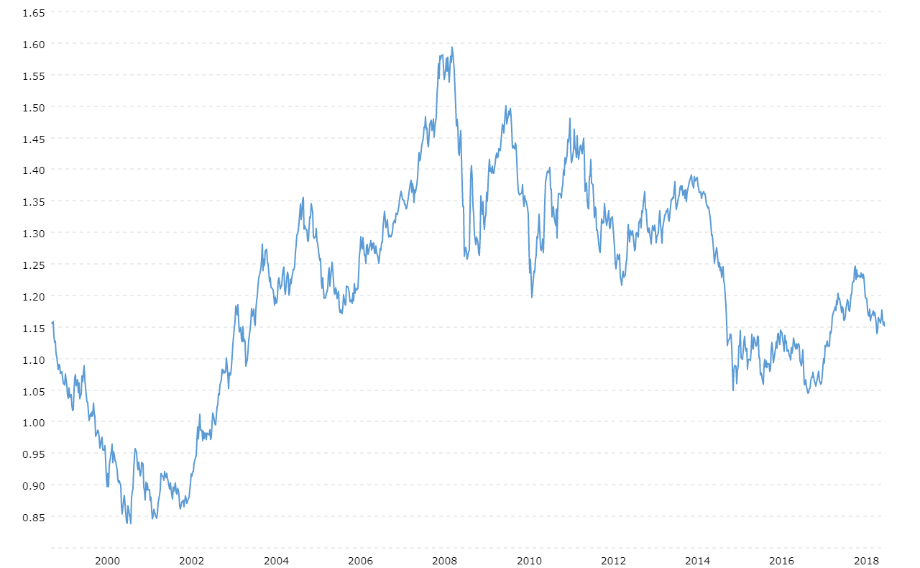
NTE 1010 – Introduction to Finance for Engineers
Foreign Exchange Markets
Worth of € in $

